Slide 1
Augmented Random Search
A Summary
By
Ping Chen
Dhruwaksh Dave
Nihanjali Mallavarapu
Mandy Wong

Slide 2
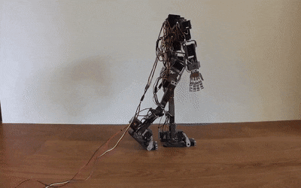
Simple Random Search provides a competitive approach to reinforcement learning
Horia Mania Aurelia Guy Benjamin Recht
Department of Electrical Engineering and Computer Science
University of California, Berkeley March 20, 2018
https://arxiv.org/pdf/1803.07055
Cited by over 100 papers*
As on 11/26/19

Slide 3
What is Augmented Random Search?
ARS is a shallow reinforcement learning algorithm. It is shallow, because, unlike many other reinforcement learning algorithms, it only has a single perceptron instead of an entire neural network as its framework.

Slide 4
The Problem Statement
The target is to find a policy to maximize the expected reward that the agent might get when following this policy in the given environment, which is typical of every Reinforcement Learning problem.

Slide 5
Approach to Solving the Problem
The solution proposed by the paper is to enhance an existing algorithm called Basic Random Search.
A Guide to Basic Random Search-
The idea of Basic Random Search is to pick a parameterized policy *𝜋𝜃, vary the parameters 𝜃 by applying +𝛎𝜹 and -𝛎𝜹 (where 𝛎 < 1 is a constant noise and 𝜹 is a random number generated from a normal distribution).
*Parameterized Policy:A parameterized policy defines the learning agent's way of behaving at a given time for certain constraints. Roughly speaking, a policy is a mapping from perceived states of the environment to actions to be taken when in those states.

Slide 6
Steps to Perform Basic Random Search
Apply the actions based on 𝜋(𝜃+𝛎𝜹) and 𝜋(𝜃-𝛎𝜹) then collect the rewards r(𝜃+𝛎𝜹) and r(𝜃-𝛎𝜹) resulting from those actions.
Now that we have the rewards of the changed 𝜃, compute the average = 1/N * Σ[r(𝜃+𝛎𝜹) - r(𝜃-𝛎𝜹)]Δ for all the 𝜹 and we update the parameters 𝜃 using Δ and a learning rate 𝝰.

Slide 7
Augmented Random Search
Dividing by the Standard Deviation 𝞼ᵣ- As iterations go on, the difference between r(𝜃+𝛎𝜹) and r(𝜃-𝛎𝜹) can vary significantly,the update 𝜃ʲ⁺¹ = 𝜃ʲ + 𝝰.Δ might oscillate considerably. Our goal is to make 𝜃 converge towards values that maximize rewards. To avert this type of variations we divide 𝝰.Δ by 𝞼ᵣ (Standard Deviation of the collected rewards).
Normalizing the States-The normalization of states ensures that policies put equal weight on the different components of the states. The normalization technique used in ARS consists of subtracting the current observed average of the state, from the state input and divide it by the standard deviation of the state: (state_input-state_observed_average)/state_std
Using top performing directions-sort the rewards in the decreasing order based on the key max(r(𝜃+𝛎𝜹), r(𝜃-𝛎𝜹)). Then use only the top b rewards (and their respective perturbation 𝜹) in the computation of the average reward.

Slide 8

Conclusion
The authors assert that they have built an algorithm that is at least 15 times more efficient than the fastest competing model-free methods on MuJoCo* locomotion benchmarks.
Mathematically, it is represented as-

Slide 9
Key Points Learnt
1. Perceptron : The perceptron is a mathematical computing model which consists of 4
parts- Input values, Weights, Sum and Activation function.
All the inputs are multiplied with given weights and added. This gives us a weighted
sum. This sum is then used to correct the activation function.
In case of ARS, there might be multiple weights and hence we represent it in the form of
a matrix. So the output sum is the result of scalar matrix multiplication.

Slide 10
Key Points Learnt
2. Maximizing rewards : The environment provides a reward for each episode. An episode
starts when the humanoid in our environment starts to walk and ends when it falls or it
might be according to certain constraints like timeout or reaching a certain goal. In order
for our AI to learn how to walk, certain feedback is provided to the model which is called
reward. This reward is used by the AI to adjust the weight.

Slide 11
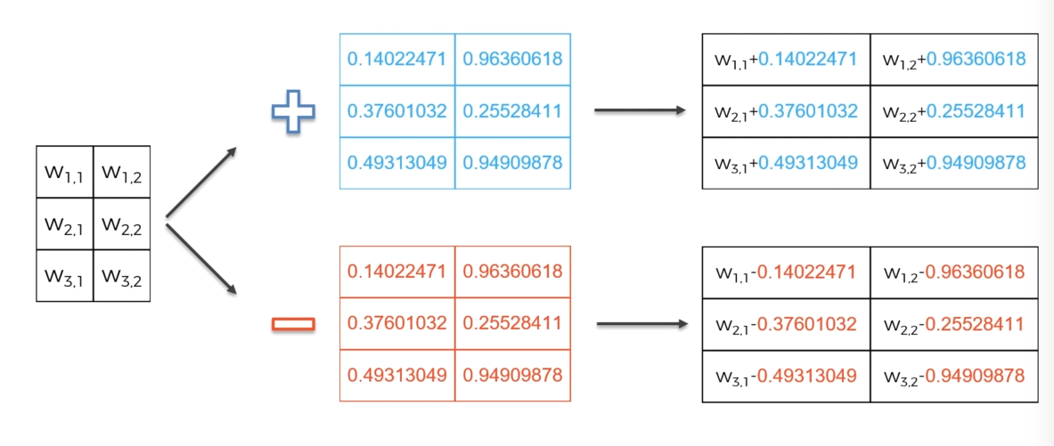
Key Points Learnt
3.The algorithm starts by calculating perturbations from the original weight matrix.

Slide 12
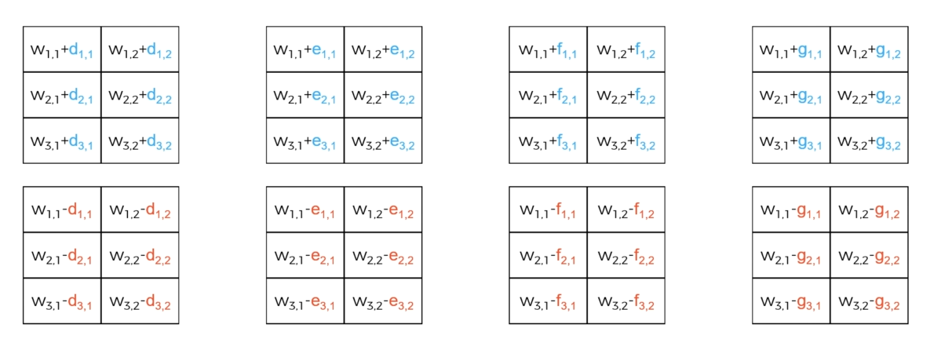
Key Points Learnt
Two sets of 16 matrices are calculated by adding and subtracting very small random numbers from the original matrix.

Slide 13
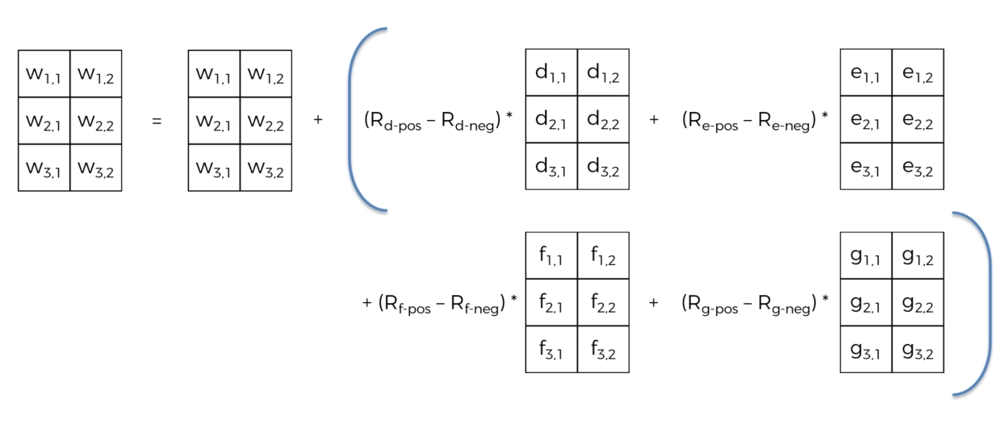
Key Points Learnt
The matrices are represented as Rd-pos, Rd-neg etc…Here R represents rewards. Some perturbations help to improve the current results which some make it worse. We try to randomly search for new weights by this methods. Now, we need to calculate the reward. This is done by calculating the finite differences as follows.
T

Slide 14
About MuJoCo
MuJoCo-Multi-Joint dynamics with Contact is a physics engine aiming to facilitate research and development in robotics, biomechanics, graphics and animation, and other areas where fast and accurate simulation is needed. It offers a unique combination of speed, accuracy and modeling power.
It also has more traditional applications such as testing and validation of control schemes before deployment on physical robots, interactive scientific visualization, virtual environments, animation and gaming.

